Slide 1
Portfolio Optimization using Machine Learning and Markowitz Theory
Mohammad askari

Slide 2
Project Overview
Phase 1: Data exploration & cleaning
Phase 2: Feature engineering, automation, SQLite
Phase 3: Predictive modeling, evaluation, end-to-end integration

Slide 3
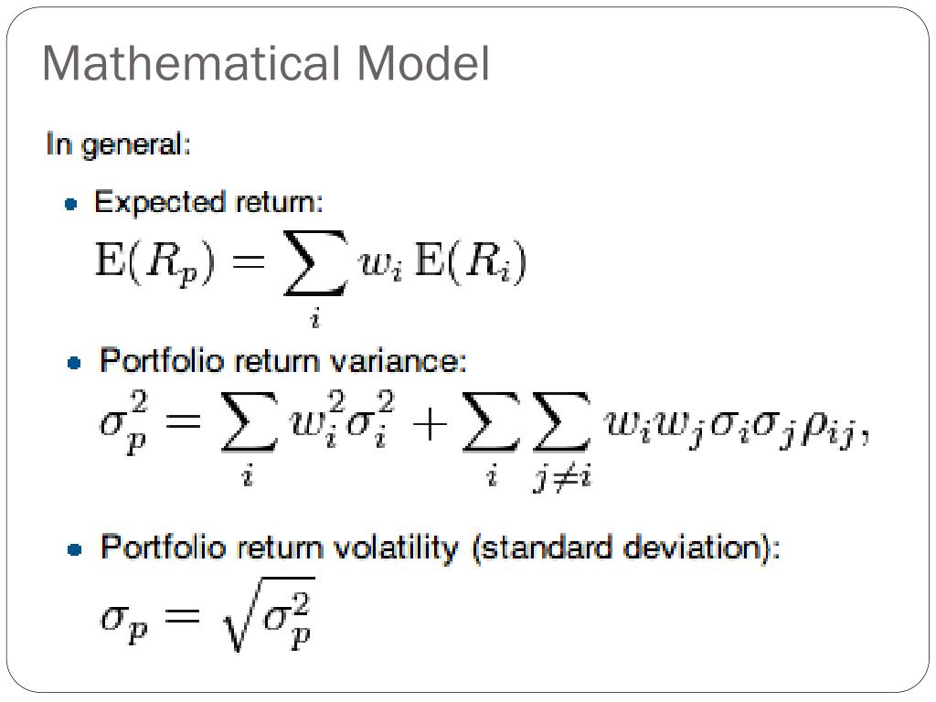
What is Markowitz theory ?

Slide 4
Data & Features
Dataset: all_stocks_5yr.csv (S&P 500, 2013–2018)
Key features:
price metrics (open, close, etc.)
engineered: daily_return, log_return, volatility_20d
Output target: mean_return_20d

Slide 5
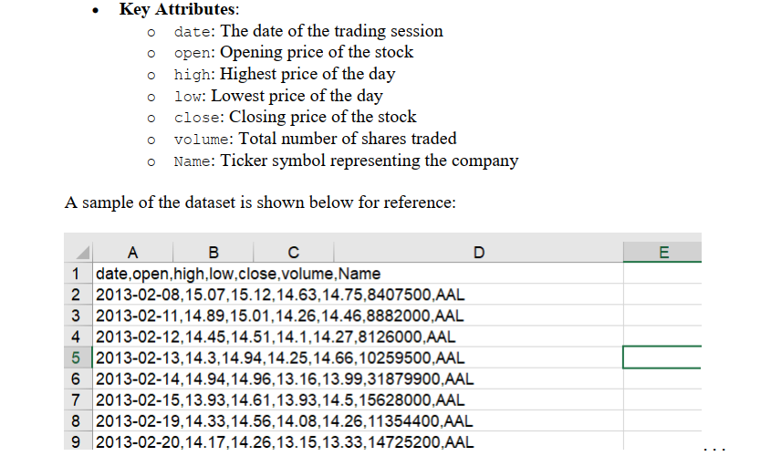
Data & Features

Slide 6
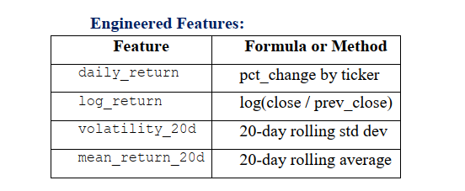
Data & Features

Slide 7
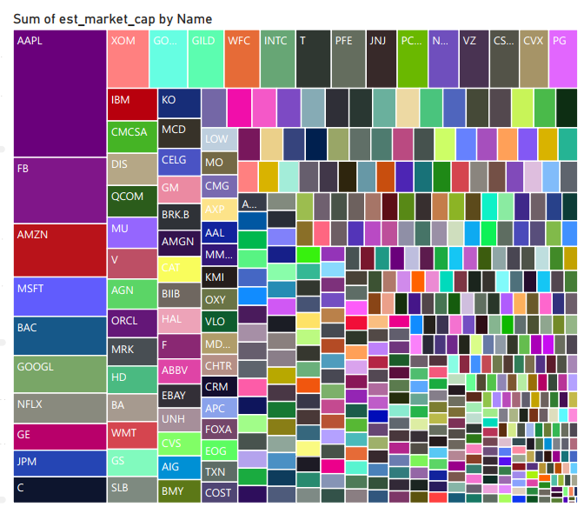
Market cap

Slide 8
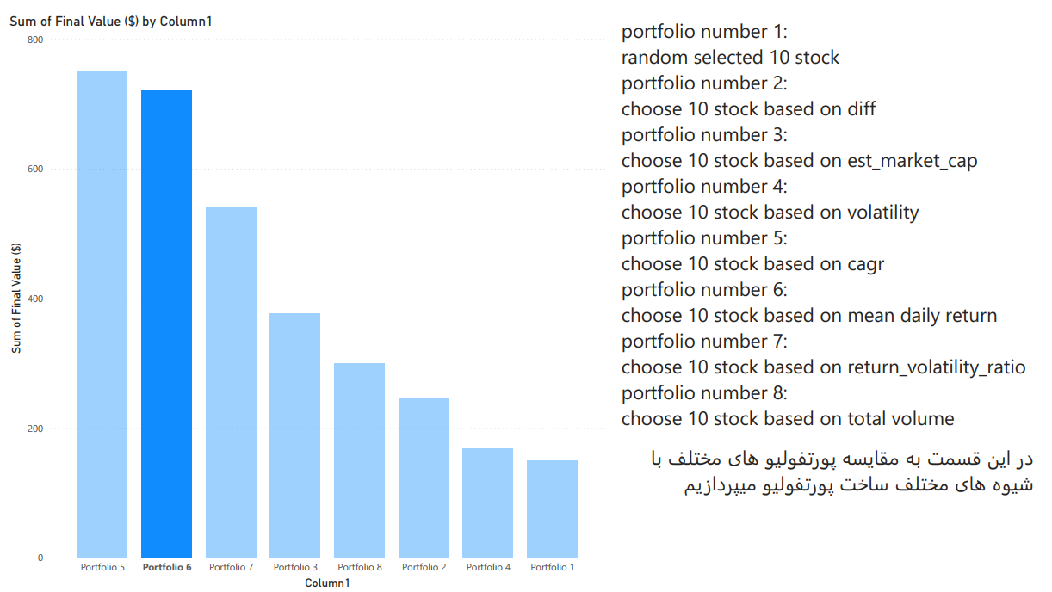
Portfolio selection methods

Slide 9
model Design
Chosen model: XGBoost Regressor
Target: predicted_mean_return_20d
PCA (3 components)
GridSearchCV

Slide 10
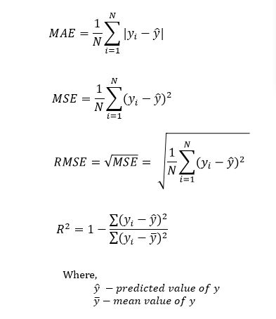
Evaluation Metrics
Regression metrics (per stock):
MAE, RMSE, R²
Portfolio metrics:
Return, Risk (Volatility), Sharpe Ratio
Visualization: Efficient Frontier

Slide 11
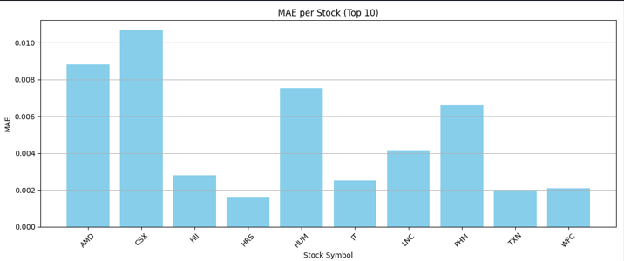
Evaluation Metrics

Slide 12
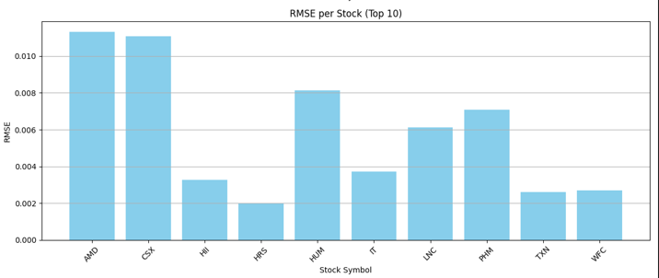
Evaluation Metrics

Slide 13
Full Pipeline Automation
run_pipeline.py single command
Executes:
Data loading
Preprocessing
Training
Prediction & Portfolio Optimization
Stored outputs: CSV, SQLite

Slide 14
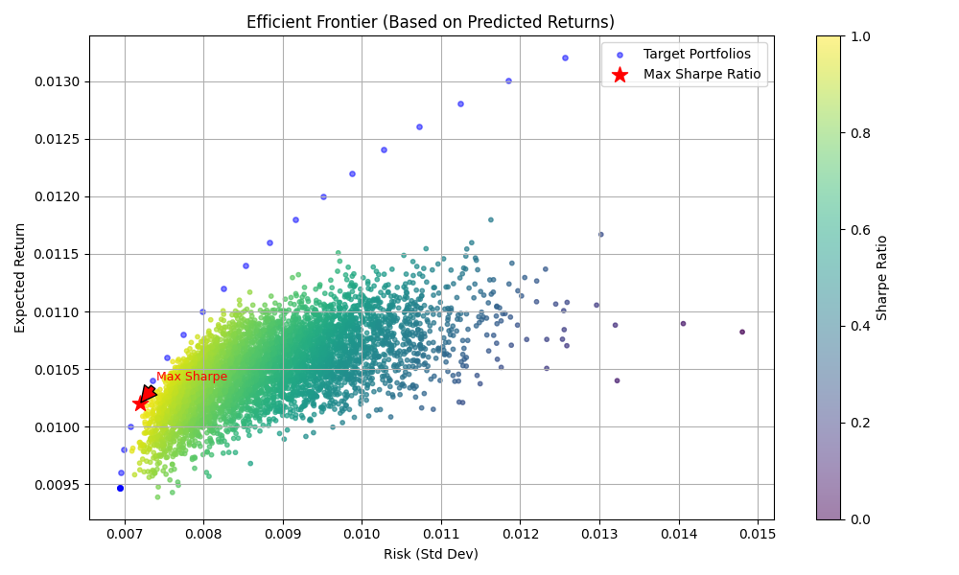
Results & Plots

Slide 15
final portfolio
Weight | Symbol
0.09100503445510517 | CSX
0.03003239252722244 | HII
0.22891061737623697 | HRS
0.15771587675332735 | HUM
0.10452051365885769 | IT
0.17169125540081911 | LNC
0.1271135920067373 | PHM
0.05655776123784681 | TXN
0.03245295658384725 | WFC

Slide 16
final portfolio
Return: 0.0105
Risk: 0.0072
Sharpe ratio: 1.45

Slide 17
Thank you!

